Slide 1
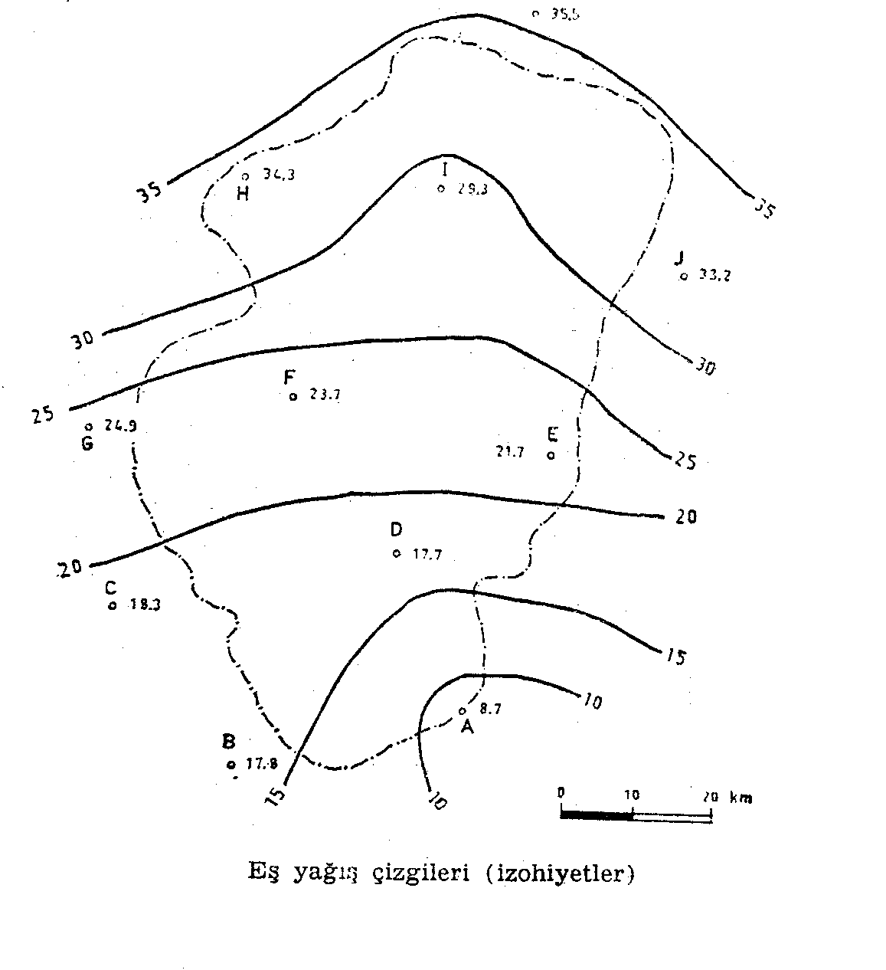
1. The precipitation values measured during a storm in the basin given below is listed. Calculate the mean precipitation values in the area with arithmetical mean method, Thissen method and isohyet method (the interval of isohyets will be 5 mm).
.

Slide 2
ARITHMETICAL MEAN METHOD:In this method, the arithmetic average of the remaining readings are taken considering only the scale of the basin boundaries.
Gage | Precipitation P_{i}(mm)
A | 8.7
B | 17.8
C | 18.3
D | 17.7
E | 21.7
F | 23.7
G | 24.9
H | 34.3
I | 29.3
J | 33.2
K | 35.5

Slide 3
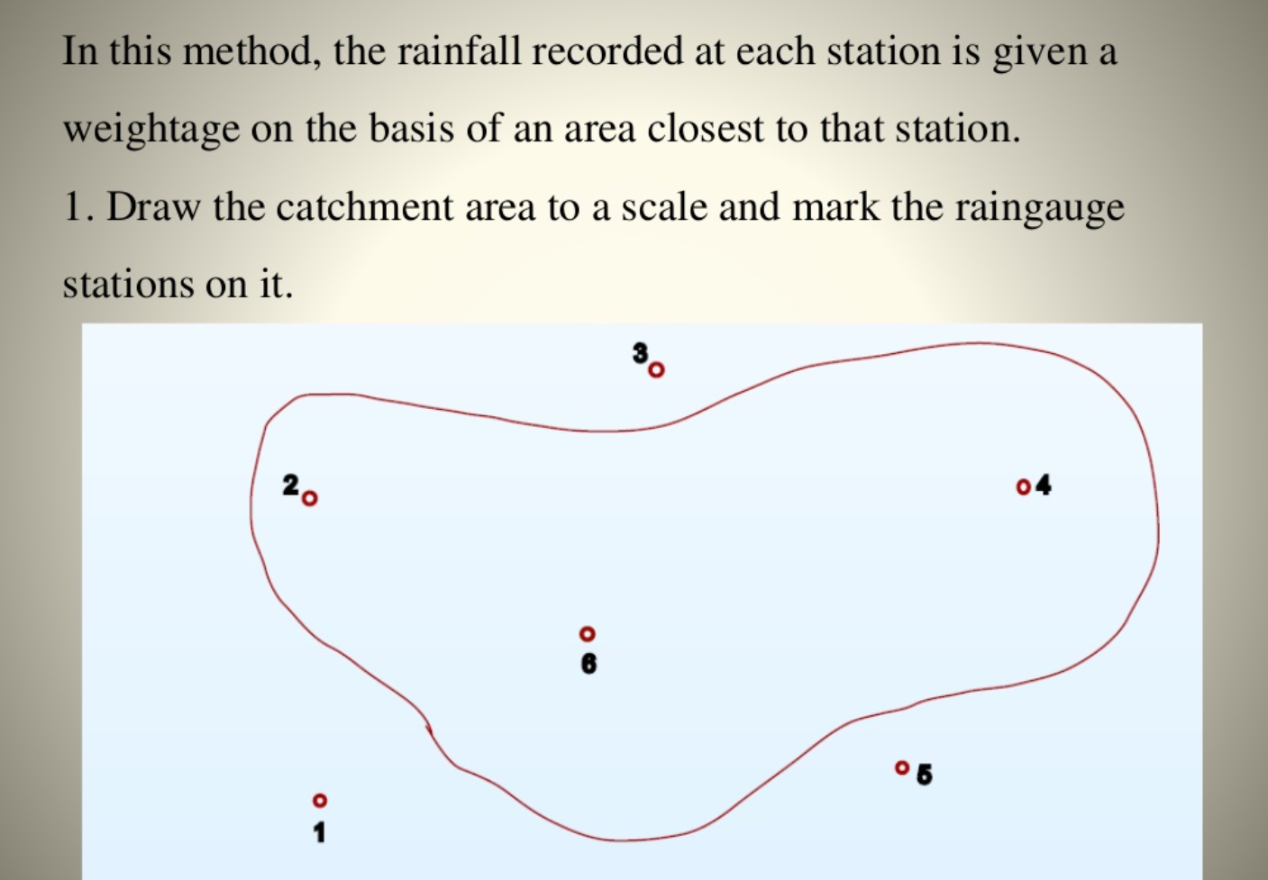
Lecture 2
Precipitation (process, measurements)
Thiessen Polygon
For each point nearest measuring point is of importance
**This method does not take into account area characteristics
**easy to process in GIS
The polygons formed by the perpendicular bisectors and part of catchment boundary are influence areas of each stations
4

Slide 4
Lecture 2
Precipitation (process, measurements)
The polygons formed by the perpendicular bisectors and part of catchment boundary are influence areas of each stations
Thiessen Polygon
For each point nearest measuring point is of importance
**This method does not take into account area characteristics
**easy to process in GIS
4

Slide 5
THİESSEN METHOD
İn this method the rainfall recorded at each station is given a weightage on basis of an area closest to that station.
Gage | PrecipitationP_{i}(mm) | Thissen Poligon Area A_{i} (km²) | P_{i}A_{i}
A | 8.7 | 233.10 | 2027.97
B | 17.8 | 644.91 | 11479.40
C | 18.3 | 481.74 | 8815.84
D | 17.7 | 186.48 | 3300.70
E | 21.7 | 85.47 | 1854.70
F | 23.7 | 828.80 | 19642.56
G | 24.9 | 160.58 | 3998.44
H | 34.3 | 297.85 | 10216.26
I | 29.3 | 903.91 | 26484.56
J | 33.2 | 297.85 | 9888.62
K | 35.5 | 248.64 | 8826.72
Toplam |  | 4369.33 | 106535.77

Slide 6
Isohyet Method:
isohyet | P_{i} (mm) | A_{i} (km²) | P_{i}A_{i} | A=ΣA_{i} (km²) | Σ P_{i}A_{i} | P_{ort} (mm)
35-30 | 32.5 | 1103.34 | 35858.55 | 1103.34 | 35858.55 | 32.5
30-25 | 27.5 | 818.44 | 22507.10 | 1921.78 | 58365.65 | 30.4
25-20 | 22.5 | 1186.22 | 26689.95 | 3108.00 | 85055.60 | 27.4
20-15 | 17.5 | 924.63 | 16181.03 | 4032.63 | 101236.63 | 25.1
15-10 | 12.5 | 300.44 | 3755.50 | 4333.07 | 104992.13 | 24.2
<10 | 7.5 | 36.26 | 271.95 | 4369.33 | 105264.08 | 24.1
TOPLAM |  | 4369.33 | 105264.08

Slide 7
2. The reservoir surface area of a dam is given as 32 km². The daily heat energy absorbed by the reservoir is 500 kal/cm² and the albedo of the water surface is 10%. Calculate the daily evaporation volume in the shade (the heat variations due to the inflow and outflow will be neglegted and the temperature of the reservoir will be assumed to be constant).
Solution 2-)
H_{i}=Incoming heat (sunshine and inflow heat)=500 cal/cm²
Albedo = reflection ratio of heat reaching the earth’s surface =%10
(for plants = 0.05-0.025…..for water = 0.05-0.15…..for snow = 0.050-0.090)
H₀ = Outflow heat plus heat reflected from the surface = 500*0.1=50 cal/cm²
ΔH=0
R=Bowen Ratio=(Heat loss from the surface by conduction/evaporation energy)=0.2-0.3
L=specific evaporation heat of water(under noramal atm. conditions 590 cal/cm³)
Daily evaporation heigth
daily evaporation volume = 0.00061m*32*10⁶m²=1.952.000 m³

Slide 8
3. A 100 km² sized area near Diyarbakır is being used for the purposes given below. Considering there is no precipitation in summer months calculate how much irrigation water is needed in summer months using Blaney-Criddle formula.
Plant | Growth Area (km²) | k (seasonal) | Month | Mean Temp. (°C) | p | U(mm)
Wheat | 80 | 0.8 | June | 26 | 0.1008
 |  |  | July | 31 | 0.1022
Clover | 20 | 0.4 | August | 30.2 | 0.0954
 |  |  | September | 25 | 0.0839
Many approaches are available in the literature
Formulas at a glance

Slide 9
U=45k.p.(t+18)
U=Monthly Evapotranspiration
k=coefficient related to planting
p=ratio of dayligth duration of the month to the annual dayligth duration
t=monthly mean temperature
According to these U1=159.67 mm U2=180.28 mm U3=82.76 mm U4=64.94 mm
Necessary Irrigation Water =U1*80*10⁶= 12 773 600 m³
=U2*80*10⁶= 14 422 400 m³
=U3*20*10⁶= 1 655 200 m³
=U4*20*10⁶= 1 295 800 m³

Slide 10
4.In Maden precipitation gage located in the Dicle Dam basin the precipitation values for the durations 1, 2, 3, 6, 12 and 24 hours, and for return periods 5, 10, 25, 50 and 100 years are given below. Draw the “precipitation intensity — duration — frequency” curve of Maden precipitation gage using this information.
Storm Duration (hour) | Return Period (year) | Total Precipitation P (mm) | Precipitation Intensity i (mm/hour)
1 | 5 | 32 | 32
 | 10 | 38 | 38
 | 25 | 47 | 47
 | 50 | 51 | 51
 | 100 | 56 | 56
2 | 5 | 44 | 22
 | 100 | 79 | 39.5
3 | 5 | 53 | 17.67
 | 100 | 96 | 32
6 | 5 | 70 | 11.67
 | 100 | 125 | 20.83
12 | 5 | 82 | 6.83
 | 100 | 146 | 12.17
24 | 5 | 96 | 4
 | 10 | 110 | 4.58
 | 25 | 136 | 5.67
 | 50 | 150 | 6.25
 | 100 | 170 | 7.08
i= delta P/delta t
İ=(170/24)=7,08

Slide 11
Return Period
Duration(hour)

